Slide 1

Lecture 3: Hydrogen Atom
http://www.moleculestothemax.com/

Slide 2
Recapitulation: Basics of Quantum Mechanics
Schrödinger equation: Classical wave equation for
de Broglie waves
Eigenvalue equation:
Expectation values:
Boundary conditions: Quantization

Slide 3
Recapitulation: Free Particle
No Quantization, all energies are allowed

Slide 4
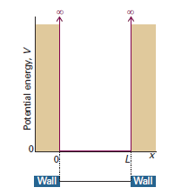
Recapitulation: Particle in 1-D Square-Well Potential
Boundary Conditions:
Normalization:

Slide 5
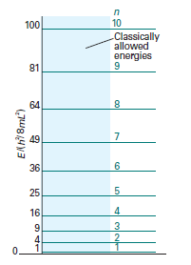
Recapitulation: Particle in 1-D Square-Well Potential
Hexatriene is a linear molecule of length 7.3 Å
It absorbs at 258 nm
Use particle in a box model to explain the results.
Agrees well with the experimental value of 258 nm
Particle in a box is a good model



Six π electron fill lower three levels

Slide 6
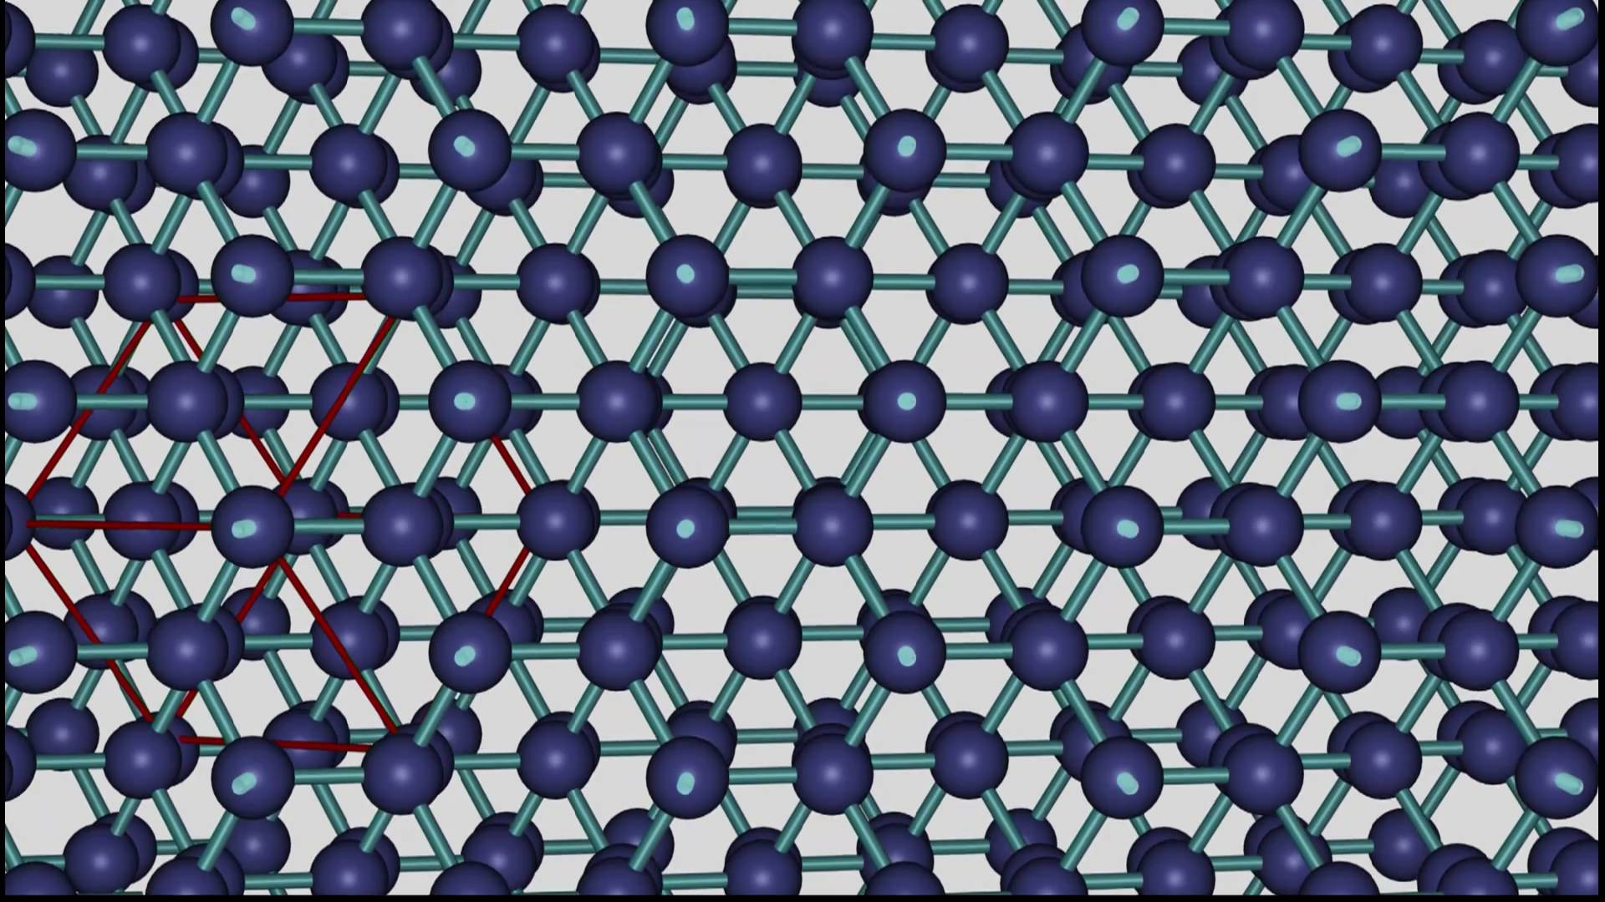
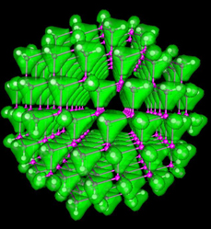
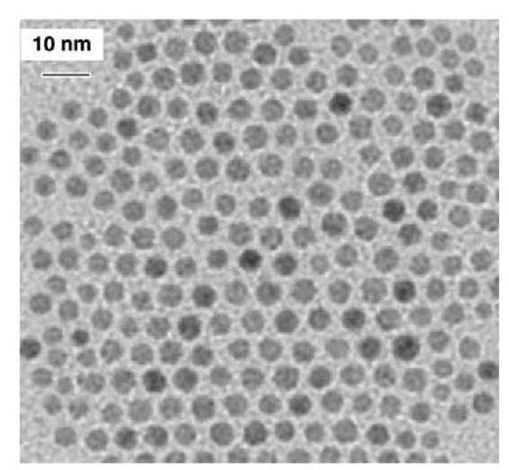
Recapitulation: Particle in 1-D Square-Well Potential
Quantum Dots – Quasi-particle (exciton) in a Box!
-
+
-
+
-
+
CB
CB
CB
VB
VB
VB
Band gap changes due to confinement,
and so will the color of emitted light

Slide 7
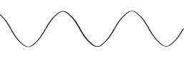

Recapitulation: Particle in 2-D Square-Well Potential
V=0
L_{y}
L_{x}
Square Box
⇒ L_{x} = L_{y} = L
Separation of variables

Slide 8

Recapitulation: Particle in 2-D Rectangular-Well Potential
V=0
L_{y}
L_{x}

Slide 9
Recapitulation: Symmetry and Degeneracy
V=0
V=0
L_{y}
L_{y}
L_{x}
L_{x}
(1,3)
(3,1)
(1,3)
(3,2)
(2,2)
(2,2)
(1,2)
(3,1)
(2,1)
(1,2)
(2,1)
(1,1)
(1,1)

Slide 10
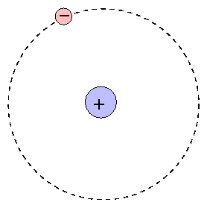
Hydrogen Atom
(x_{e},y_{e},z_{e})
Two particle central-force problem
Completely solvable – a rare example!
(x_{N},y_{N},z_{N})

Slide 11
Hydrogen Atom
Schrödinger Equation

Slide 12
Hydrogen Atom: Relative Frame of Reference
Separation of Ĥ into Center of Mass and Internal co-ordinates
z
m_{e}(x_{e},y_{e},z_{e})
r_{e}
r_{eN}
-
CM
M_{N}
(x_{N},y_{N},z_{N})
R
r_{N}
y
x

Slide 13
Hydrogen Atom: Relative Frame of Reference
Checkout Appendix-1

Slide 14
Hydrogen Atom: Separation to Relative Frame
Hydrogen atom has two particles the nucleus and electron with co-ordinates x_{N},y_{N},z_{N} and x_{e},y_{e},z_{e}
The potential energy between the two is function of relative co-ordinates x=x_{e}-x_{N}, y=y_{e}-y_{N}, z=z_{e}-z_{N}
Appendix-1
z
m_{e}(x_{e},y_{e},z_{e})
r_{e}
r_{eN}
-
CM
R
M_{N}
(x_{N},y_{N},z_{N})
r_{N}
y
x

Slide 15
Hydrogen Atom: Separation to Relative Frame
Appendix-1
z
m_{e}(x_{e},y_{e},z_{e})
r_{e}
r_{eN}
-
CM
R
M_{N}
(x_{N},y_{N},z_{N})
r_{N}
y
x

Slide 16
Hydrogen Atom: Separation to Relative Frame
Appendix-1

Slide 17
Hydrogen Atom: Separation to Relative Frame
In the above equation the first term represent the kinetic energy of the center of mass (CM) motion and second term represents the kinetic energy of the relative motion of electron and
Appendix-1

Slide 18
Hydrogen Atom: Separation of CM motion
Free particle!
Kinetic energy of the atom

Slide 19
Hydrogen Atom: Electronic Hamiltonian

Slide 20
Hydrogen Atom: Electronic Hamiltonian
Not possible to separate out into three different co-ordinates. Need a new co-ordinate system

Slide 21
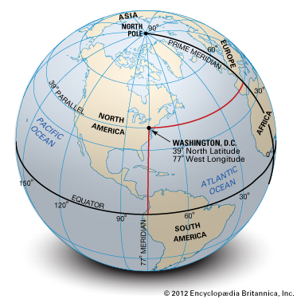
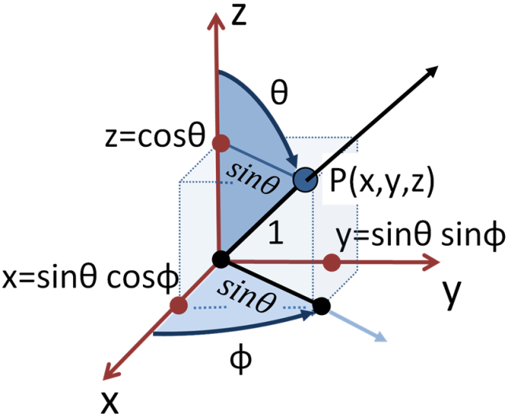
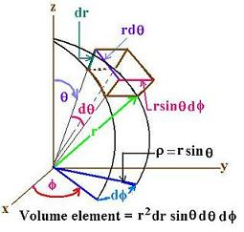
Spherical Polar Co-ordinates
r:0 to ∞
θ: 0 to π
φ: 0 to 2π

Slide 22
Laplacian in Spherical Coordinates

Slide 23
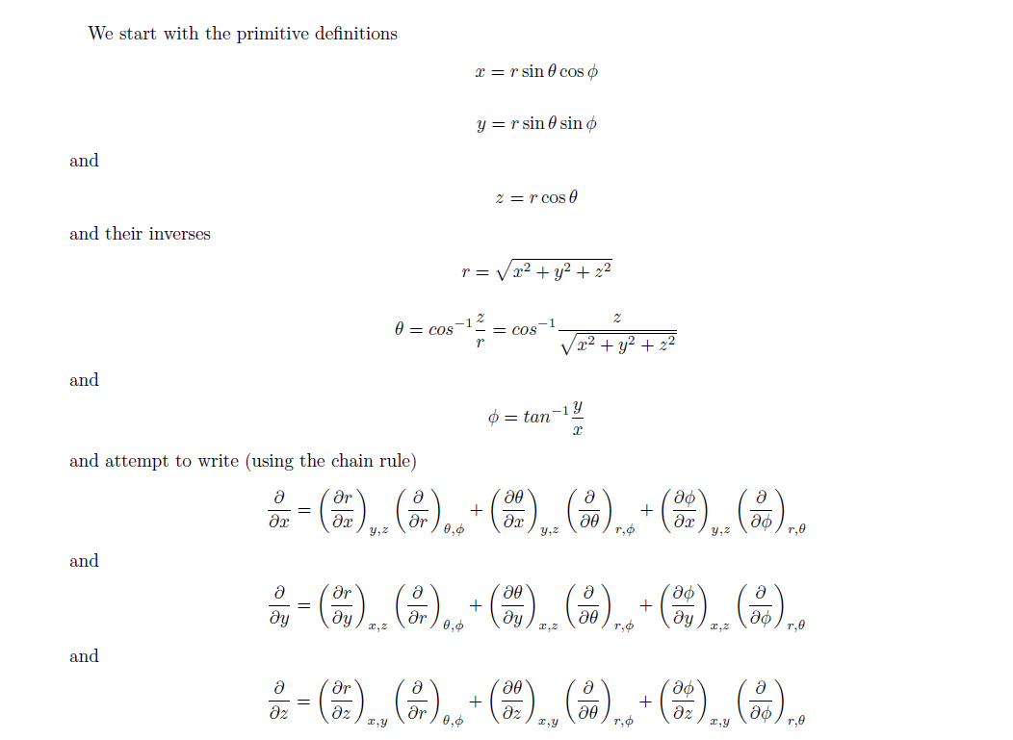
Laplacian in Spherical Coordinates
Appendix-2

Slide 24
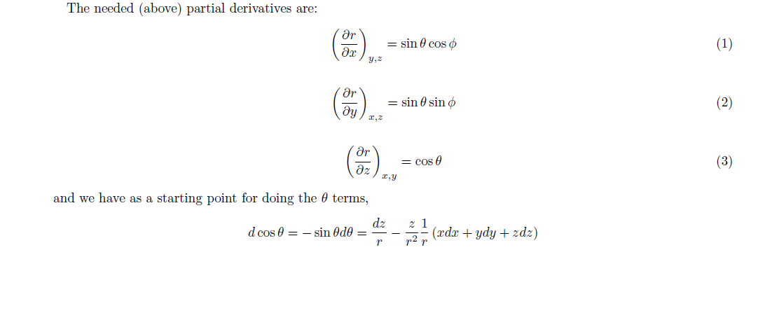
Laplacian in Spherical Coordinates
Appendix-2

Slide 25
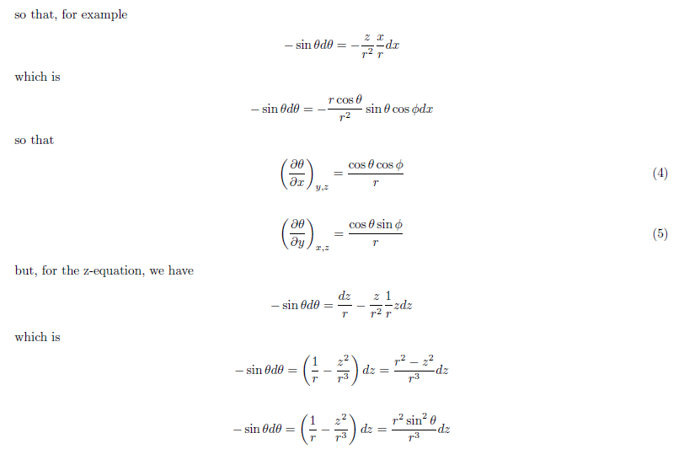
Laplacian in Spherical Coordinates
Appendix-2

Slide 26
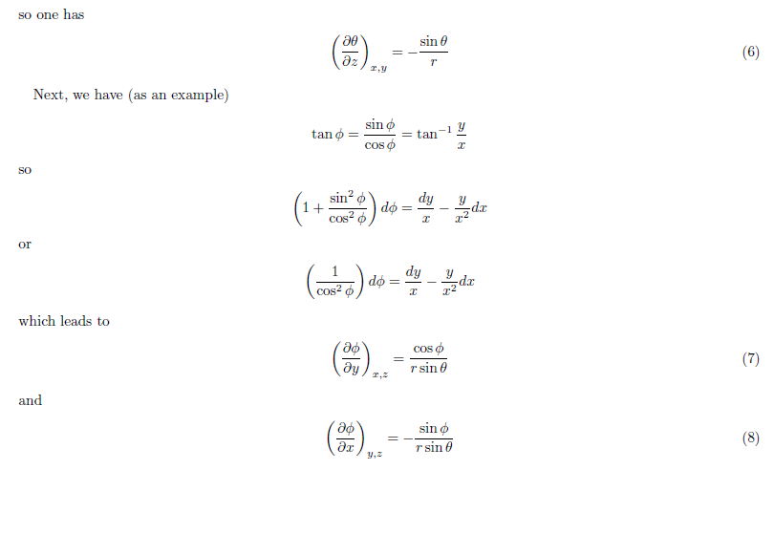
Laplacian in Spherical Coordinates
Appendix-2

Slide 27
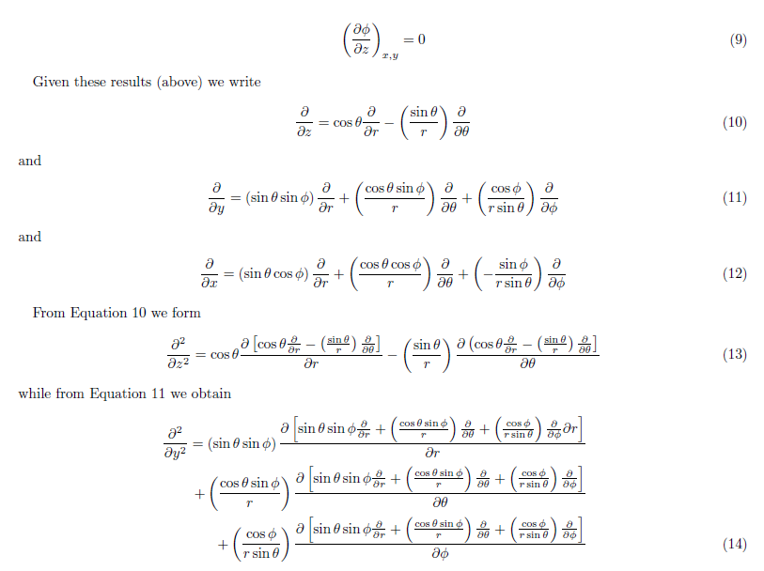
Laplacian in Spherical Coordinates
Appendix-2

Slide 28
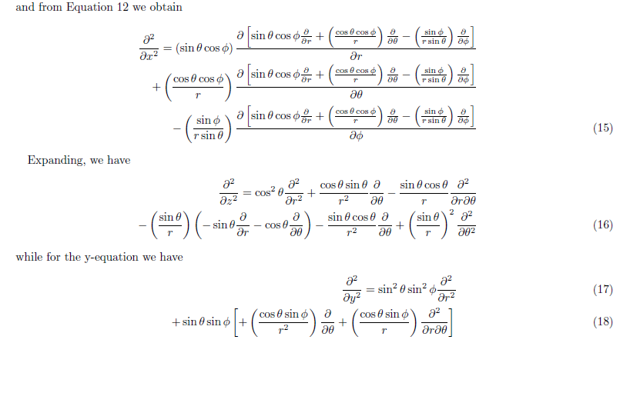
Laplacian in Spherical Coordinates
Appendix-2

Slide 29
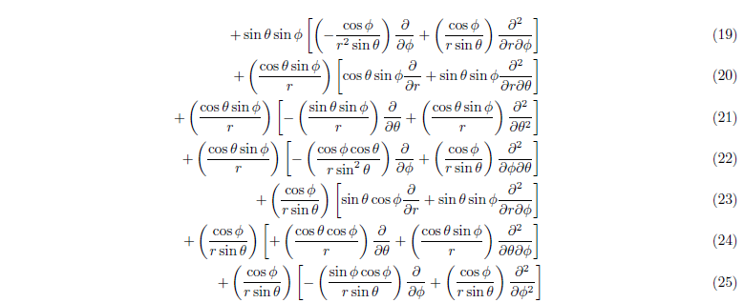
Laplacian in Spherical Coordinates
Appendix-2

Slide 30
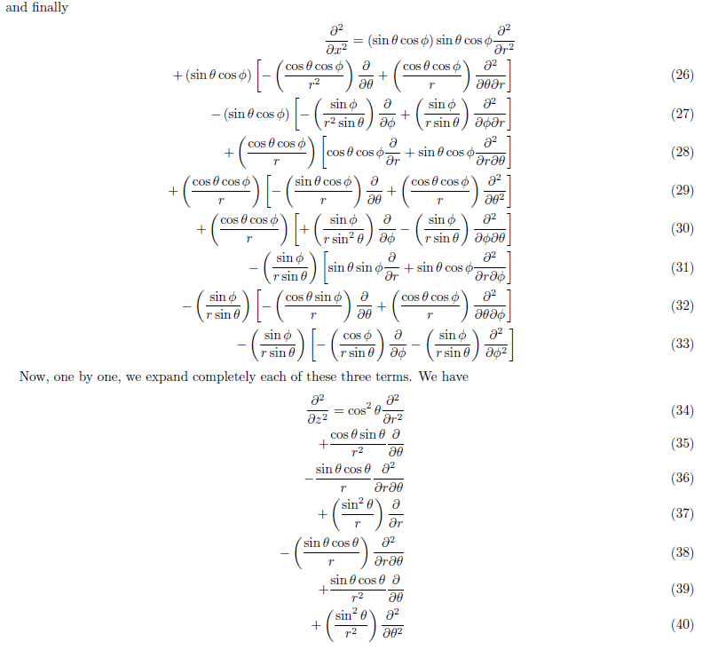
Laplacian in Spherical Coordinates
Appendix-2

Slide 31
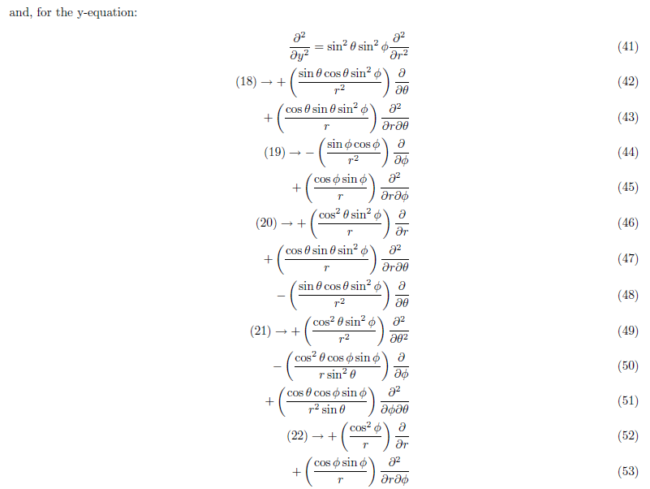
Laplacian in Spherical Coordinates
Appendix-2

Slide 32
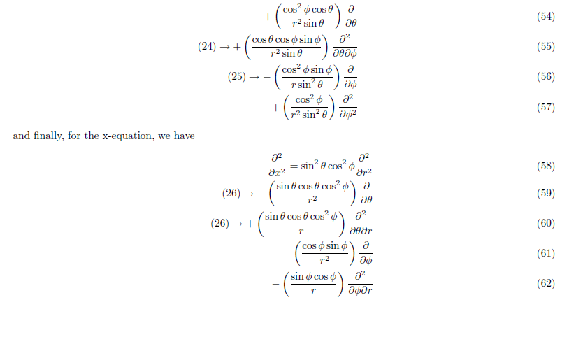
Laplacian in Spherical Coordinates
Appendix-2

Slide 33
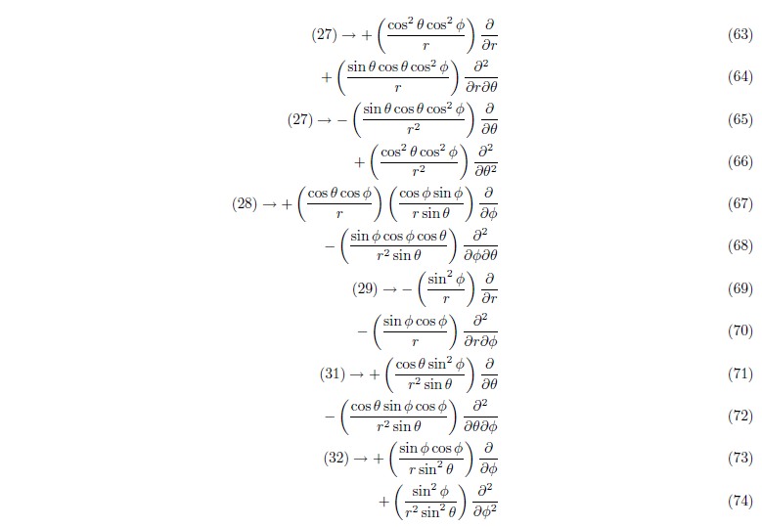
Laplacian in Spherical Coordinates
Appendix-2

Slide 34
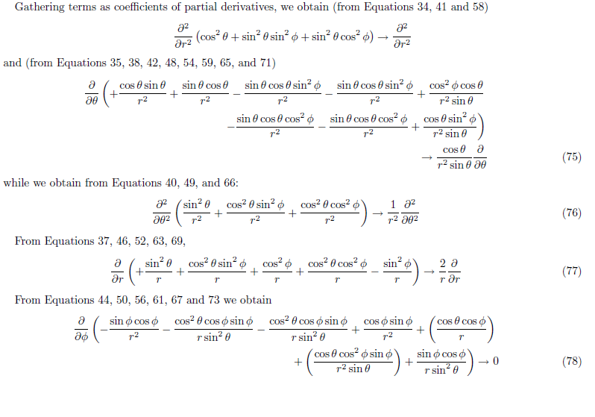
Laplacian in Spherical Coordinates
Appendix-2

Slide 35
Laplacian in Spherical Coordinates

Slide 36
Kinetic energy operator in Spherical Coordinates

Slide 37
Hamiltonian in Spherical Coordinates

Slide 38
Schrodinger equation for the electronic part in Spherical Polar Co-ordinates

Slide 39
Schrodinger equation for the electronic part in Spherical Polar Co-ordinates
and bring all the terms to the LHS

Slide 40
Separation of variables

Slide 41
Separation of variables
Upon differentiation

Slide 42
Separation of variables

Slide 43
Separation of variables
Radial
Angular
=β
A constant

Slide 44
Separation of variables
Radial equation
Angular equation

Slide 45
Separation of variables
Radial equation
Angular equation

Slide 46
Separation of variables
The three variables r, θ and φ are separated

